Slide 1
CUSTOMER CHURN PREDICTION
USING Machine Learning Technology
Submitted to:
Mrs. Harvinder Kour
GLA University , Mathura
Presented By:
Ankur Omar
171500051

Slide 2
INTRODUCTION
Customer churn is a major problem and one of the most important concerns for large companies. Due to the direct effect on the revenues of the companies, especially in the telecom field, companies are seeking to develop means to predict potential customer to churn. Therefore, finding factors that increase customer churn is important to take necessary actions to reduce this churn.
The objective of the project is to reducing customer churn by identifying the potential churn customer and take proactive actions to make them stay.

Slide 3
GOALS AND OBJECTIVE
The purpose of this project is to document the process I went through to create my predictions for Customer churn Prediction.
The objective of this project was to build a classification model that could successfully determine whether the customer is churn or not

Slide 4
SOFTWARE REQUIRED
TOOLS USED
1. Anaconda Navigator- 1.9.6
2. Jupyter Notebook- 5.7.4
LIBRARY USED
1. Analyzing: Numpy, Pandas , Sci-kit Learn
2. Visulization : Matplotlib , Seaborn, pandas profiling

Slide 5
IMPLEMENTATION
Importing the necessary libraries
Importing the dataset
Cleaning and analyzing the dataset
Building the model
Using logistic regression, K-NN Classifier, Support vector machine, Decision Tree , Random forest for making prediction

Slide 6
LOGISTIC REGRESSION
Logistic regression is basically a supervised classification algorithm. In a classification problem, the target variable(or output), y, can take only discrete values for given set of features(or inputs), X.
Some of the examples of classification problems are Email spam or not spam, Online transactions Fraud or not Fraud.

Slide 7
K-Nearest Neighbors
k-nearest neighbor is one of the simplest machine learning algorithm based on supervised learning technique. KNN algorithm stores all the available data and classify a new data point based on a similarity.
K-NN algorithm can be used for regression as well as classification but mostly it can be used for classification problem
It is also called lazy learner algorithm because it does not learn from training set immediately instead it stores the data set at time of classification, it performs an action on dataset.

Slide 8
Support Vector Machine
Support vector machine or SVM is one of the most popular supervised algorithms. This is used for both classifications as well as regression problem. But primarily it is used for classification problem.
The goal or target of support vector machine is to create the best line or decision boundary that can segregate n –dimensional space in to classes so that we can easily put the new data point in the correct category in future. This best decision boundary is called hyper plane

Slide 9
Decision Tree Classifier
Decision Tree is a Supervised learning technique that can be used for both classification and Regression problems, but mostly it is preferred for solving Classification problems.
It is a tree-structured classifier, where internal nodes represent the features of a dataset, branches represent the decision rules and each leaf node represents the outcome.

Slide 10
Random Forest Classifier
Random Forest is a popular machine learning algorithm that belongs to the supervised learning technique. It can be used for both Classification and Regression problems in ML
It is based on the concept of ensemble learning, which is a process of combining multiple classifiers to solve a complex problem and to improve the performance of the model.
Random Forest is a classifier that contains a number of decision trees on various subsets of the given dataset and takes the average to improve the predictive accuracy of that dataset.

Slide 11
IMPLEMENTATION
Importing the necessary libraries
Importing the dataset
Cleaning and analyzing the dataset
Building the model
Using logistic regression, K-NN Classifier, Support vector machine, Decision Tree, Random forest for making prediction

Slide 12
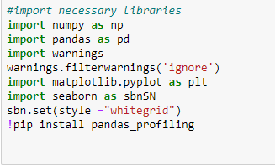
IMPORTING THE NECESSARY LIBRARIES

Slide 13

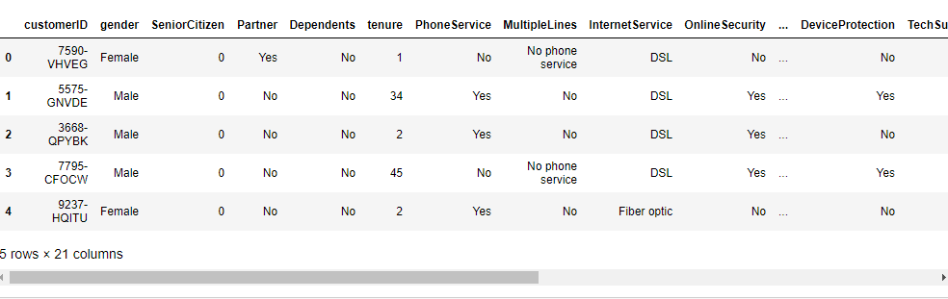
THE DATASET

Slide 14
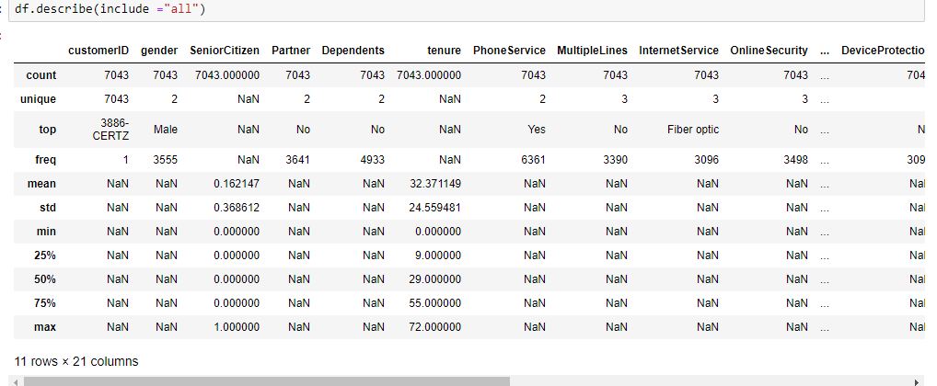
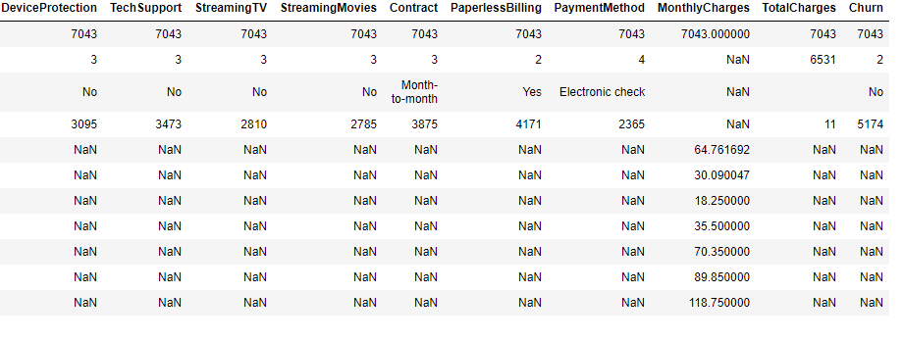
CLEANING AND ANALYSING THE DATA

Slide 15
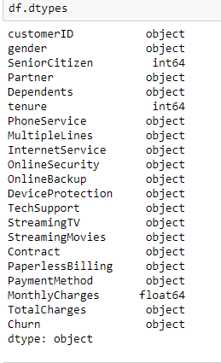
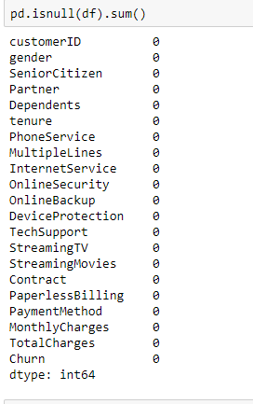
CLEANING AND ANALYSING THE DATA
D

Slide 16
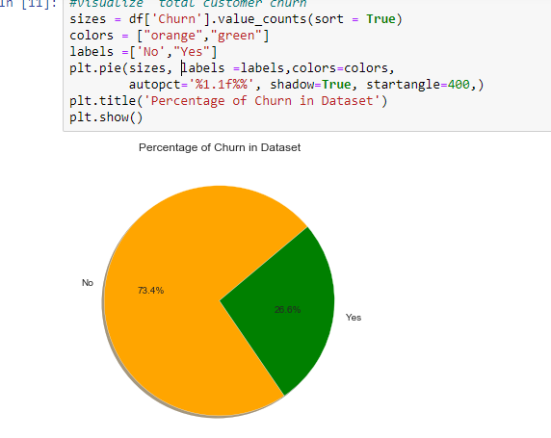
Percentage Of Churn

Slide 17
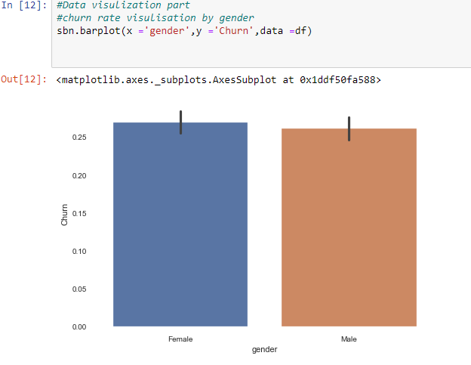

Slide 18
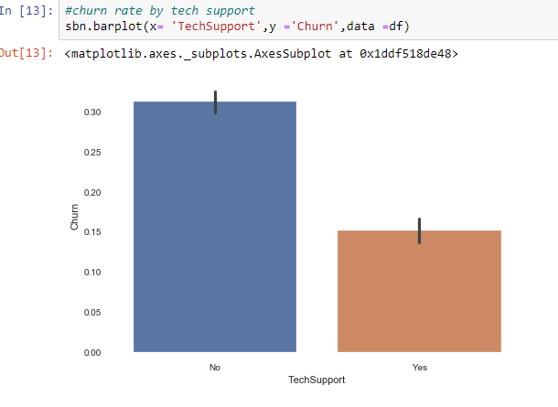

Slide 19
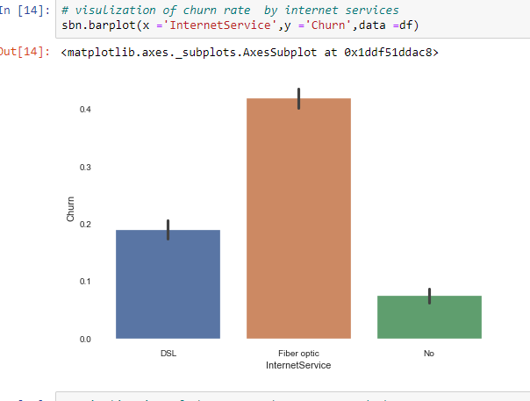

Slide 20
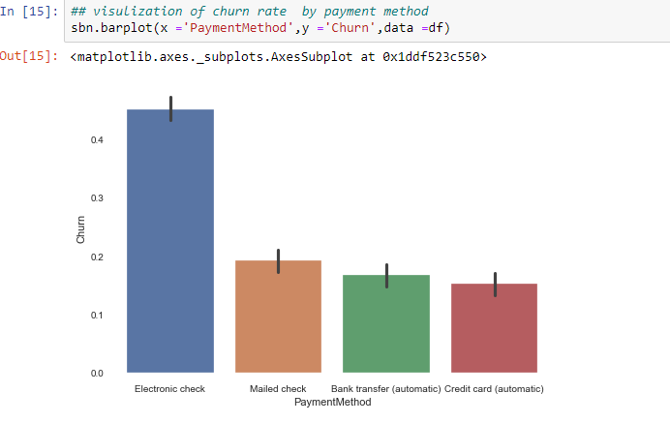

Slide 21
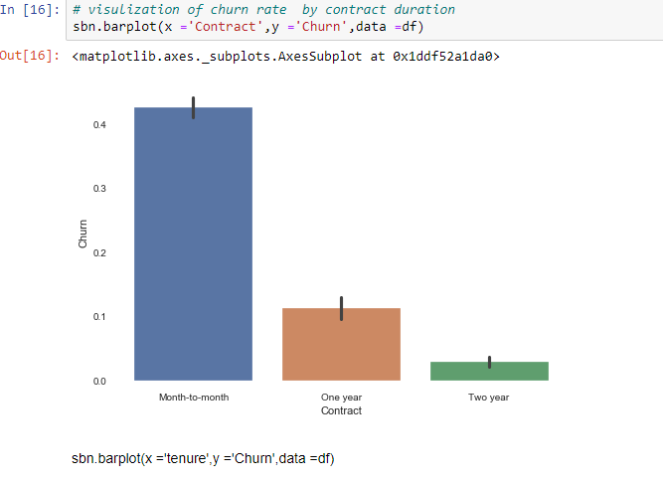

Slide 22
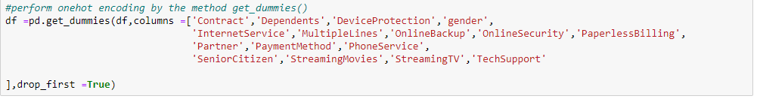
ONE HOT ENCODING
Here we have performed one hot encoding for some attributes by the help of get dummies() method

Slide 23
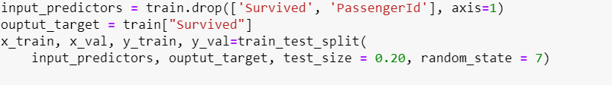
Building The Model
Train Set: 80% Test/Cross Validation Set:20%

Slide 24


Making Predictions and Calculating Accuracy:

Slide 25
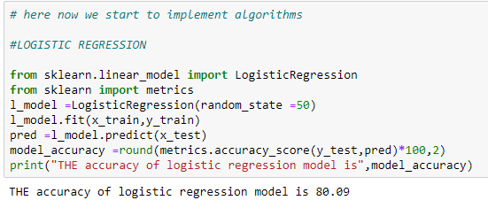
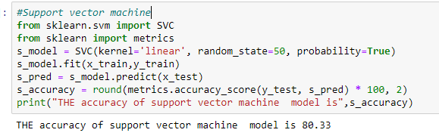
Training The Model
Logistic Regression Support Vector Machine

Slide 26
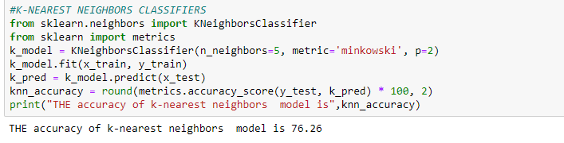
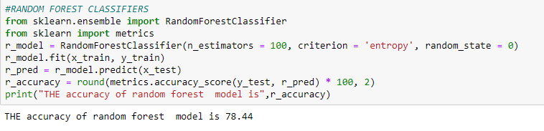
Training The Model
KNN Classifier Random Forest Classifier

Slide 27
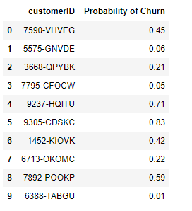
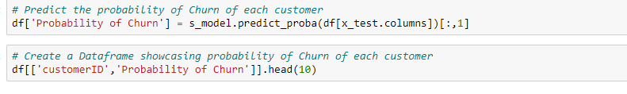
Results

Slide 28
CONCLUSION
The main contribution of our work is to develop a churn prediction model which assists telecom operators to predict customers who are most likely subject to churn.
The model developed in this work uses machine learning techniques. The model experimented four algorithms: Decision Tree, Random Forest, Logistic Regression and KNN Algorithm and Support Vector Machine. However, the best results were obtained by applying Support Vector Machine algorithm.

Slide 29
REFERENCES
Analyzing Titanic disaster using machine learning algorithms -Computing, Communication and Automation (ICCCA), 2017 International Conference on 21 December 2017, IEEE.
Eric Lam, Chongxuan Tang, "Titanic Machine Learning From Disaster", LamTangTitanic Machine Learning From Disaster, 2012.
A.NG CS229 Notes, Stanford University ,2012

Slide 30
THANK YOU : )

